Slide 1
Causal Representation Learning for Video Understanding
Guangyi Chen
https://chengy12.github.io/
Carnegie Mellon University, Pittsburgh PA, USA
Mohamed bin Zayed University of Artificial Intelligence, Abu Dhabi, UAE
Pacific Causal Inference Conference, 6th July

Slide 2
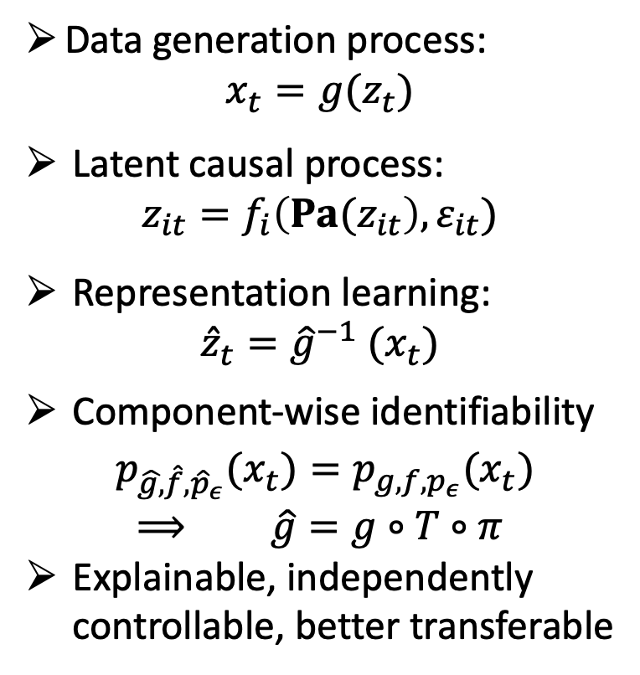
Causal Representation Learning
Given the video data, causal representation learning (CRL) aims to recover the data generation process from the observation to obtain the disentangled latent representation.
Data generation process:
$$x_{t}=g(z_{t})$$
Latent causal process:
$$z_{it}=f_{i}\left({Pa(z}_{it}\right),ε_{it})$$
Representation learning:
$${\hat{z}}_{t}={\hat{g}}^{−1} (x_{t})$$
Component-wise identifiability
${p_{\hat{g,}\hat{f},{\hat{p}}_{ε}}(x}_{t})={p_{g,f,p_{ε}}(x}_{t})$
$⟹$ $\hat{g}=g∘T∘π$
Explainable, independently controllable, better transferable

Slide 3
CRL for Video Understanding
When the learned representation can be identifiable?
How to learn the causal representation from the video data?
What can we do for video understanding if causal representation is learned?
Identification Theorem
Practical Algorithm
Real-world Application

Slide 4
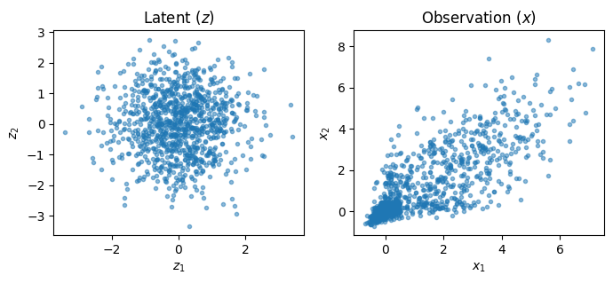
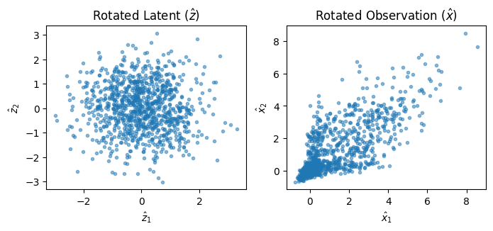
Causal Representation Learning is Hard
For the linear Gaussian case, when we add a rotation on the latent variable, the generated observation distribution is unchanged.
Original generation process
Adding a rotation on the latent variable doesn’t change the observation
We may learn the representations with the entanglement

Slide 5
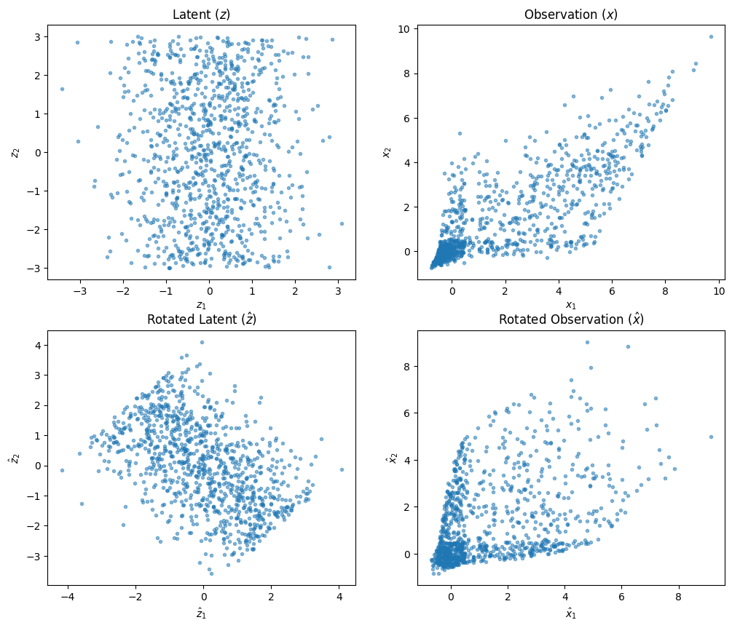
Causal Representation Learning Is Hard
For the linear non-Gaussian case, we can recover the latent variables.
For the non-linear case, we can leverage the auxiliary variables such as the domain index.
The Non-Gaussian property provides the “changeability” (sufficient change)
For the more complex non-linear case, we need more “changeability”.
Auxiliary variables, such as labels and domain index, can provide such side information.

Slide 6
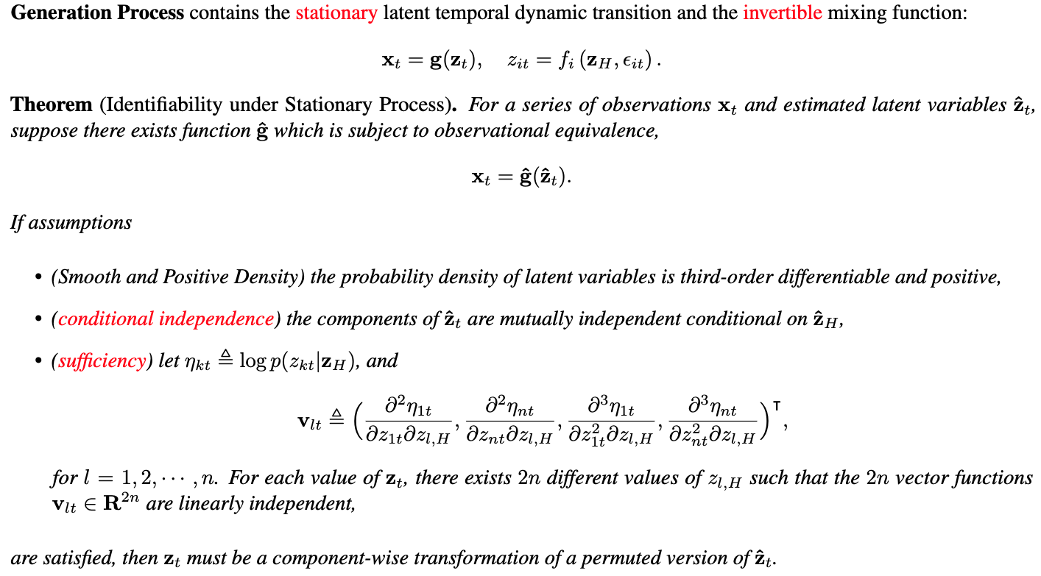
Identification Theorem

Slide 7
Identification Theorem
Stationary: The temporal transition function is fixed for the whole sequence.
Known non-stationary is an opportunity more than a challenge.
Unknown non-stationary cases cannot be identifiable since it is difficult to distinguish the
domain change or variable change.
Invertibility: The observation contains all information about the latent process.
If we cannot recover the missing information, we cannot achieve the identification.
Conditional independence: there are no instantaneous relations among the latent variables. If two variables always change jointly, we cannot say what is the unique effect of each.
Sufficiency: It means that the conditional independent change of the latent variables has sufficient influence and these changes can be captured from the observation. Image: requiring domain index or labels
Video: using the historical state as the side information

Slide 8
Identification Under More Challenges
Challenges | Scenarios | Extra Assumption | Reference
Unknown non-stationary | Bioinformatics, Speech, Volleyball Game | Domain index follows the Markov process, Mechanism Sparsity | NCTRL[3] IDEA[4]
Non-invertible mixing function | Occlusion, Video, Motion Blue | There exists context to complete the missing info. | CaRiNG[2]
Instantaneous relations | Skeleton, Stock | Sparse relations | IDOL[5]

Slide 9
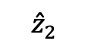
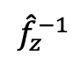
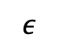
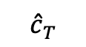
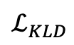
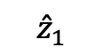
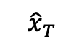
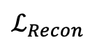
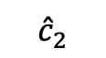
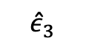
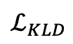
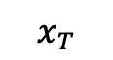
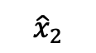
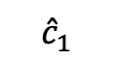
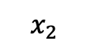
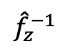
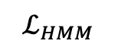
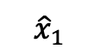
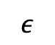
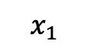
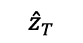
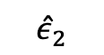
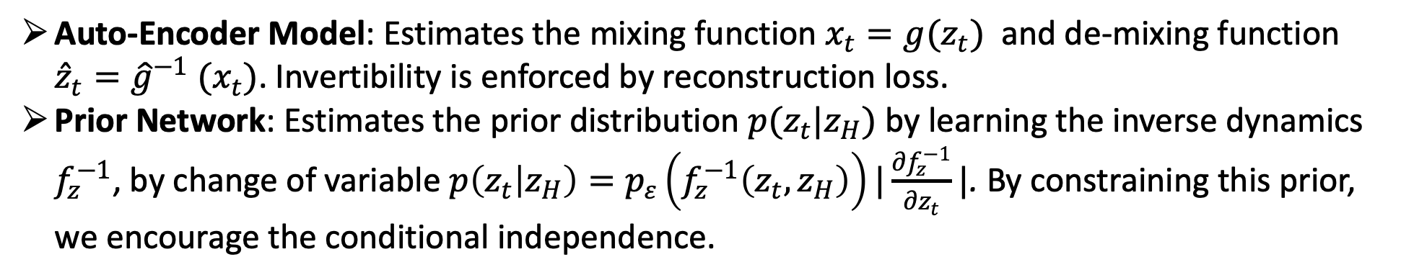
Practical Algorithm
Auto-Encoder Model: Estimates the mixing function $x_{t}=g(z_{t})$ and de-mixing function ${\hat{z}}_{t}={\hat{g}}^{−1} (x_{t})$. Invertibility is enforced by reconstruction loss.
Prior Network: Estimates the prior distribution $p(z_{t}|z_{H})$ by learning the inverse dynamics $f_{z}^{−1}$, by change of variable $p\left(z_{t} | z_{H}\right)=p_{ε}\left(f_{z}^{−1}\left(z_{t}, z_{H}\right)\right)|\frac{∂f_{z}^{−1}}{∂z_{t}}|$. By constraining this prior, we encourage the conditional independence.
…
Sequential encoder to leverage the context to recover the lost information
Autoregressive hidden Markov module to estimate transition matrix of the unknown non-stationary.
$${\hat{x}}_{1}$$
$${\hat{x}}_{2}$$
$${\hat{x}}_{T}$$
$$ε$$
$$ε$$
Decoder
$$ℒ_{KLD}$$
Decoder
$$ℒ_{KLD}$$
Decoder
…
$${\hat{ε}}_{2}$$
$${\hat{ε}}_{3}$$
$${\hat{c}}_{1}$$
$${\hat{c}}_{2}$$
$${\hat{c}}_{T}$$
…
$${\hat{z}}_{1}$$
$${\hat{f}}_{z}^{−1}$$
$${\hat{z}}_{2}$$
$${\hat{f}}_{z}^{−1}$$
$${\hat{z}}_{T}$$
$$ℒ_{Recon}$$
$$ℒ_{HMM}$$
ARHMM
Encoder
Encoder
Encoder
SeqEnc
SeqEnc
SeqEnc
…
$$x_{1}$$
$$x_{2}$$
…
$$x_{T}$$

Slide 10
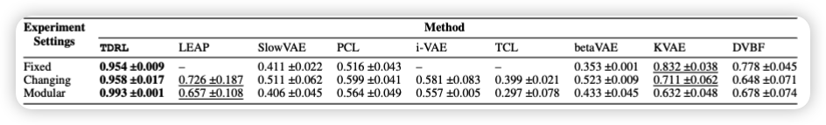
Synthetic Experiments
Apply a 2-layer MLP as the transition function and a random three-layer MLP for mixing.
Consider both the stationary scenario and non-stationary scenarios. For non-stationary scenarios, there may be only casual dynamic changes or both casual dynamic changes and global observations vary.
To add changes to the causal dynamic, we vary the values of the first layer of the MLP.
The global change component is sampled from i.i.d Gaussian distribution whose mean and variance are modulated by domain index.
Compared with baseline betaVAE, i-VAE/ TCL with independent factors, and LEAP which only models nonstationary noise.
Mean Correlation Coefficient (MCC) is used to evaluate the learned representation.

Slide 11
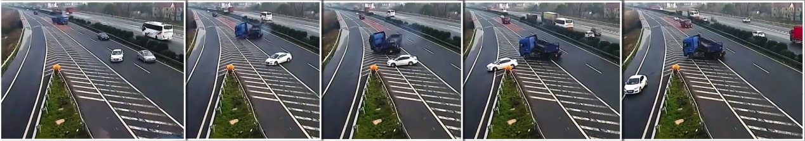
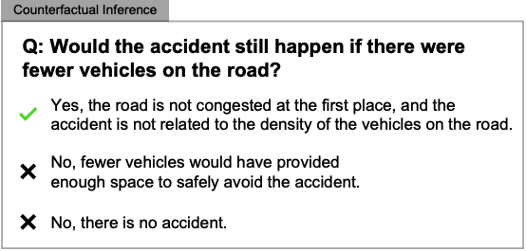
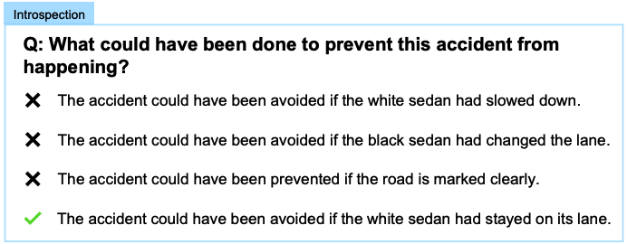
Application: Video Reasoning
Video reasoning aims to answer the neural language reasoning questions based on the video content, whose challenge lies in understanding the latent causal process.
Credited to the SUTD-TrafficQA dataset (Xu. et.al. 2021)

Slide 12


Compared with Existing VideoQA methods
Once we identify the causal dynamics, we can efficiently conduct video reasoning (such as attribution and counterfactual questions) as a causal inference process.
Formulate VideoQA as cross-modality matching.
Rely on question-answer (QA) pairs, Learn relations
Don’t require the QA pairs.
Can efficiently answer the attribution and counterfactual questions
Chen et al. LLCP: Learning Latent Causal Processes for Reasoning-based Video Question Answer. ICLR, 2024

Slide 13
Overall Framework
In the training, we learn the latent causal process from normal videos by self-supervision
During inference, we first identify the root cause and use it to select answer

Slide 14
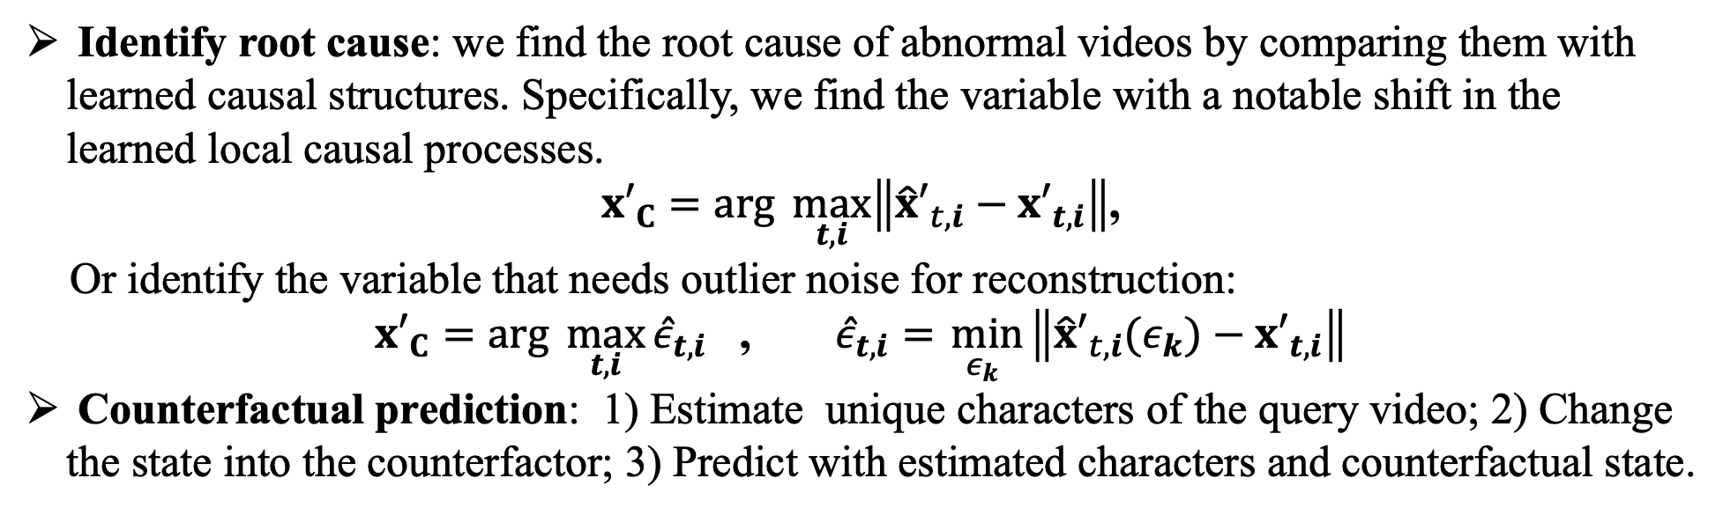
Algorithm Details
Identify root cause: we find the root cause of abnormal videos by comparing them with learned causal structures. Specifically, we find the variable with a notable shift in the learned local causal processes.
${x′}_{C}=arg \max_{t,i}\left\|{\hat{x}′}_{t,i}−{x′}_{t,i}\right\|$,
Or identify the variable that needs outlier noise for reconstruction:
${x′}_{C}=arg \max_{t,i}{{\hat{ε}}_{t,i}}$ , ${\hat{ε}}_{t,i}=\min_{ε_{k}}\left\|{\hat{x}′}_{t,i}(ε_{k})−{x′}_{t,i}\right\|$
Counterfactual prediction: 1) Estimate unique characters of the query video; 2) Change the state into the counterfactor; 3) Predict with estimated characters and counterfactual state.

Slide 15
Showcase of Experimental Results
We can identify the causal relations and thus find the root cause.

Slide 16
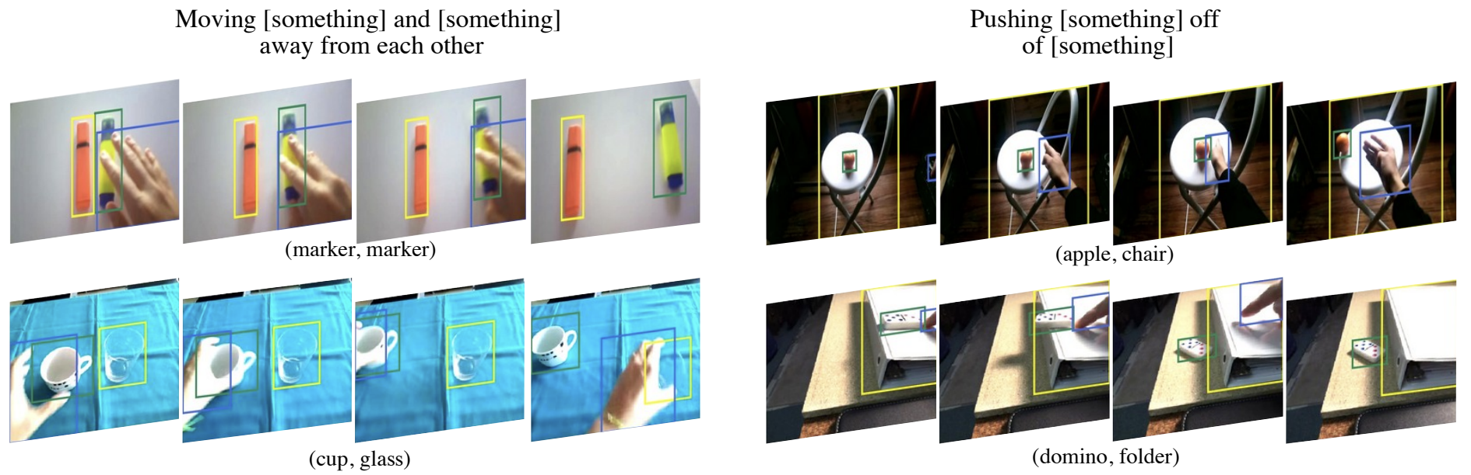
Application: Few-shot Action Recognition
Few-shot action recognition targets to efficiently transfer the learned action recognition knowledge into the new domain with few-shot examples.
Credited to the Something-Else dataset (Materzynska. 2020)

Slide 17
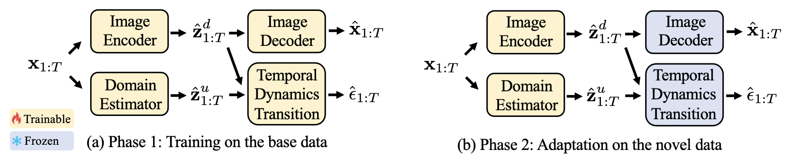
Application: Few-shot Action Recognition
Key insight: Despite different representations of actions, the underlying physical laws are invariant across different actions.
Once the causal dynamic model is identified, we fix the temporal dynamic transition function (in each domain) as a constraint to adapt to novel data.
Li et al. Learning Causal Domain-Invariant Temporal Dynamics for Few-Shot Action Recognition. ICML, 2024

Slide 18
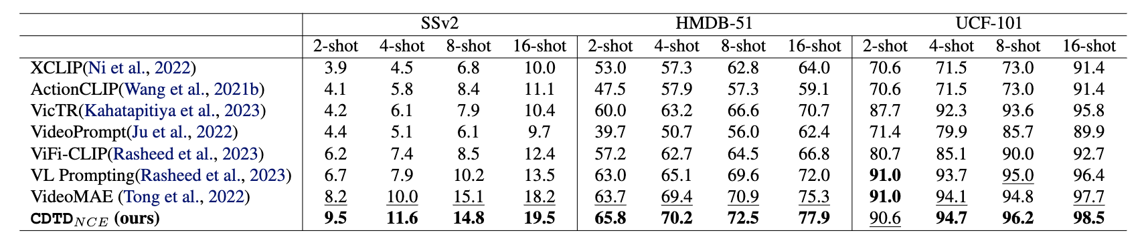
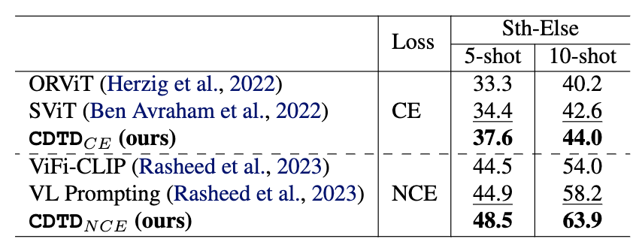
Quantitative Experimental Results
Significantly improve the few-shot action recognition performance over previous SOTAs
Also performs well in compositional action recognition task

Slide 19
Takeaway Points
Video data provides more “changeability” than static data, which can help the identification of the latent representation.
The identification results can be extended to more challenging scenarios, such as unknown non-stationary, non-invertibility, and instantaneous relations.
In the algorithm, we encourage conditional independence by adding the constraint between the learned posterior and conditional independent prior.
Learning causal representation can benefit lots of applications such as video reasoning, few-shot action recognition, and so on.

Slide 20
References
[1] Yao, W., Chen, G., and Zhang, K., “Temporally disentangled representation learning.” NeurIPS, 2022.
[2] Chen, G., Shen, Y., Chen, Z., Song, X., Sun, Y., Yao, W., Liu, X., and Zhang, K., "CaRiNG: Learning Temporal Causal Representation under Non-Invertible Generation Process." ICML, 2024.
[3] Song, X., Yao, W., Fan, Y., Dong, X., Chen, G., Niebles, J.C., Xing, E., and Zhang, K., "Temporally disentangled representation learning under unknown nonstationarity." NeurIPS, 2023.
[4] Li, Z., Cai, R., Yang, Z., Huang, H., Shen, Y., Chen, Z., Song, X., Hao, Z., Chen, G., and Zhang, K., “ When and How: Learning Identifiable Latent States for Nonstationary Time Series Forecasting. ” Preprint, 2024.
[5] Li, Z., Shen, Y., Zheng, K., Cai, R., Song, X., Gong, M., Hao, Z., Zhu, Z., Chen, G., and Zhang, K., “On the Identification of Temporally Causal Representation with Instantaneous Dependence.” Preprint, 2024.
[6] Chen, G., Li, Y., Liu, X., Li, Z., Al Suradi, E., Wei, D., and Zhang, K., LLCP: Learning Latent Causal Processes for Reasoning-based Video Question Answer. ICLR, 2024.
[7] Li, Y., Chen, G., Abramowitz, B., Anzellotti, S., and Wei, D., “Learning Causal Domain-Invariant Temporal Dynamics for Few-Shot Action Recognition.” ICML, 2024.
Notes:
Thanks for your listening, Please refer to our papers for more details. We have included some recent updates there.

Slide 21
Thanks for your listening

Slide 22
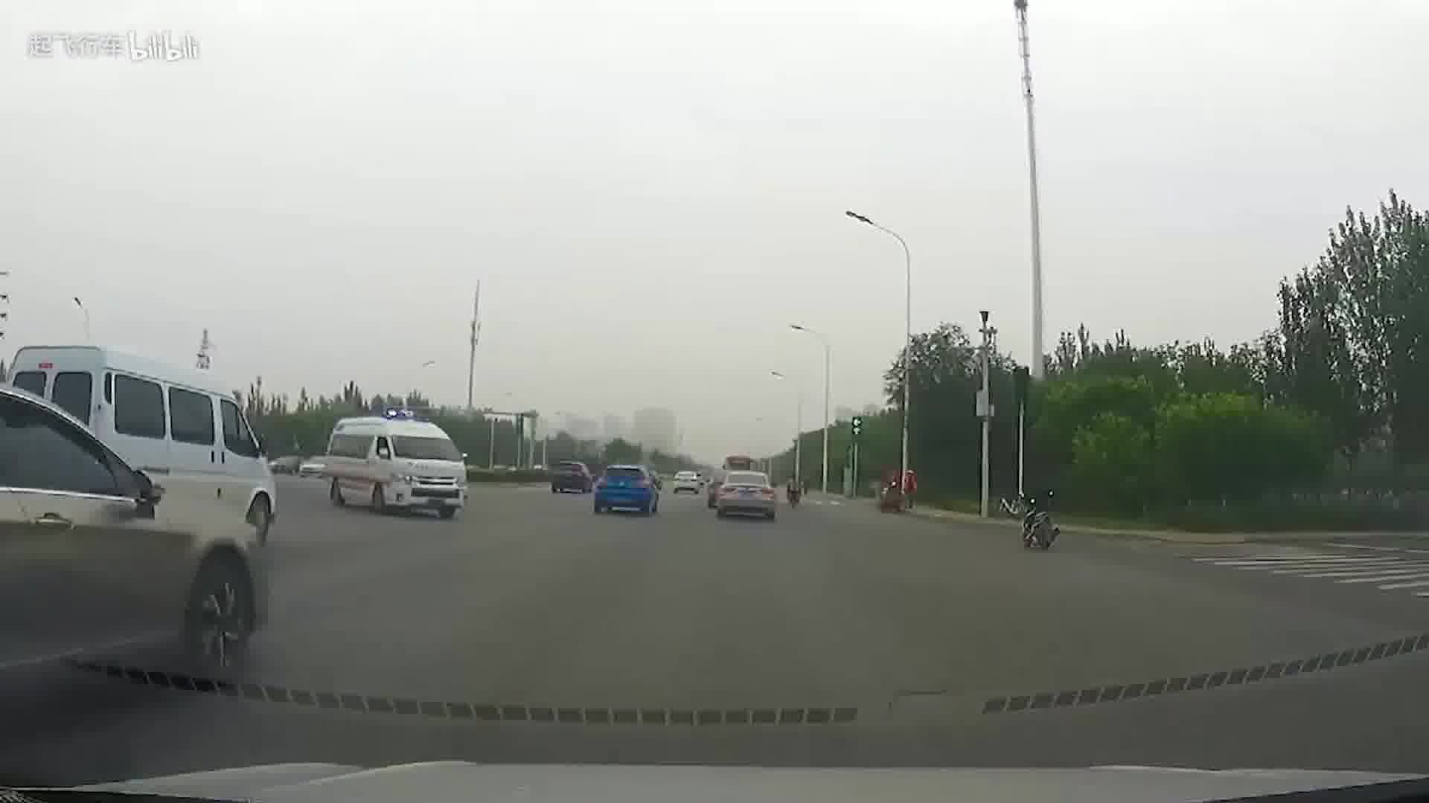
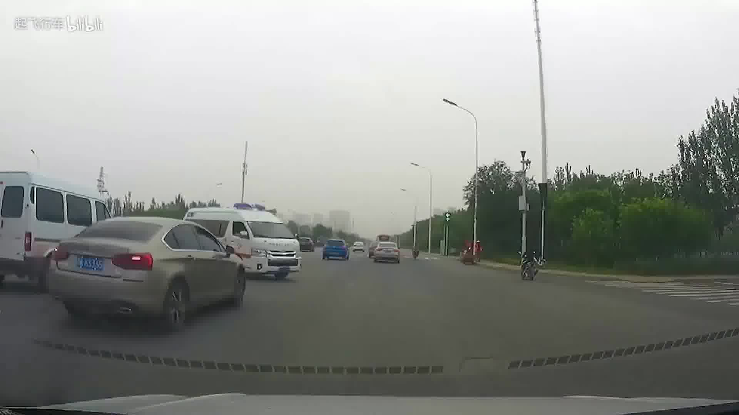
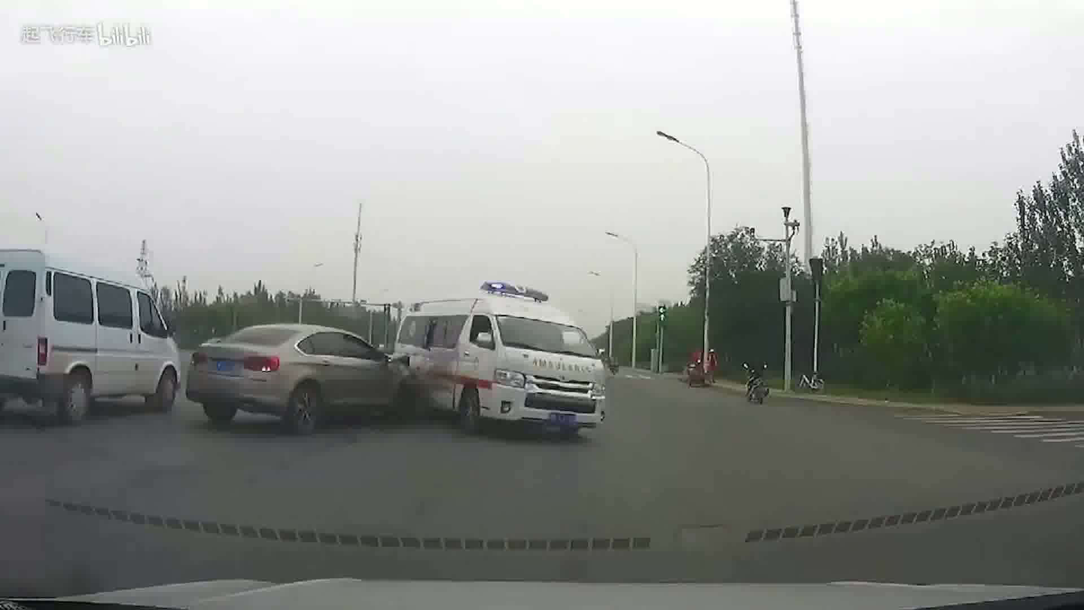
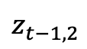
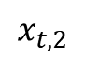
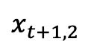
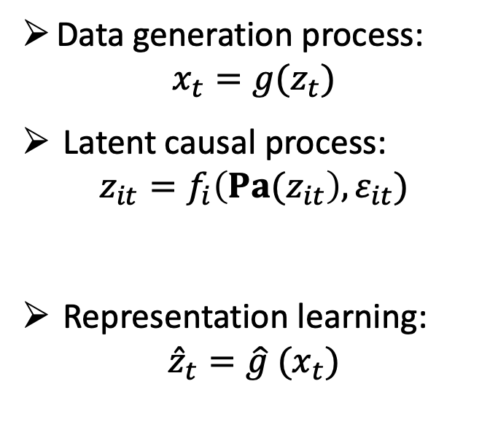
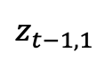
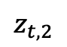
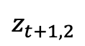
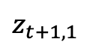
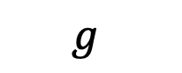
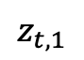





Causal Representation Learning
Given the video data, causal representation learning (CRL) aims to recover the data generation process from the observation to obtain the disentangled latent representation.
$$f$$
$$z_{t−1,1}$$
$$z_{t,1}$$
$$z_{t+1,1}$$
Data generation process:
$$x_{t}=g(z_{t})$$
Latent causal process:
$$z_{it}=f_{i}\left({Pa(z}_{it}\right),ε_{it})$$
Representation learning:
$${\hat{z}}_{t}=\hat{g} (x_{t})$$
$$z_{t−1,2}$$
$$z_{t,2}$$
$$z_{t+1,2}$$
$$g$$
$$x_{t−1,1}$$
$$x_{t,1}$$
$$x_{t+1,1}$$
$$x_{t−1,2}$$
$$x_{t,2}$$
$$x_{t+1,2}$$

